Slide 1
Ray
Lecturer: Ngo Huy Bien
Software Engineering Department
Faculty of Information Technology
VNUHCM - University of Science
Ho Chi Minh City, Vietnam
nhbien@fit.hcmus.edu.vn

Slide 2

Objectives

Slide 3

Contents

Slide 4

References
Philipp Moritz et al. (2018). Ray- A Distributed Framework for Emerging AI Applications.
Max Pumperla et al. (2023). Learning Ray. O'Reilly Media.
Stephanie Wang et al. (2021). Ownership - A Distributed Futures System for Fine-Grained Tasks.
Barbara Liskov and Liuba Shrira (1988). Promises - Linguistic Support for Efficient Asynchronous Procedure Calls in Distributed Systems.

Slide 5
Introduction
https://www.youtube.com/watch?v=oH9pJavu-PU

Slide 6
RL Applications [1]
First, RL methods often rely on simulation to evaluate policies.
Second, like their supervised learning counterparts, RL algorithms need to perform distributed training to improve the policy based on data generated through simulations or interactions with the physical environment.
Third, policies are intended to provide solutions to control problems, and thus it is necessary to serve the policy in interactive closed-loop and open-loop control scenarios.

Slide 7
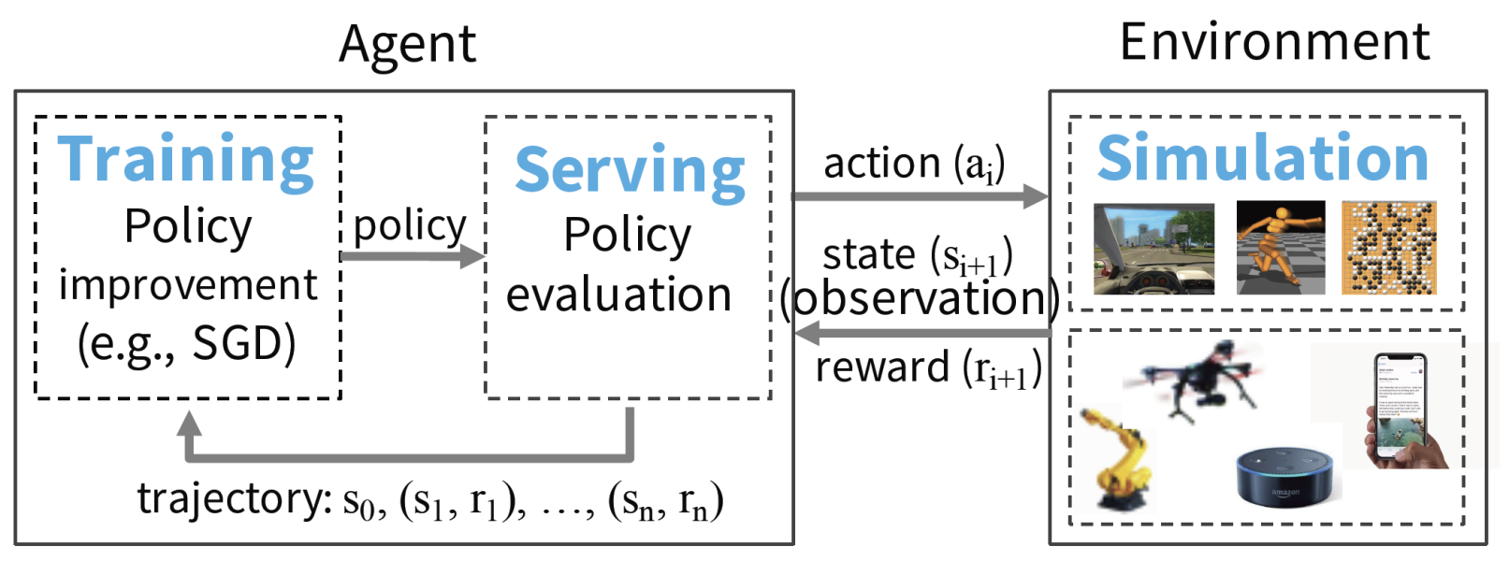
Example of an RL System

Slide 8
Ray
Ray, a general-purpose cluster-computing framework that enables simulation, training, and serving for RL applications.
To support these workloads, we unify the actor and task-parallel abstractions on top of a dynamic task execution engine.
To achieve scalability and fault tolerance, we propose a system design principle in which control state is stored in a sharded metadata store and all other system components are stateless.
To achieve scalability, we propose a bottom-up distributed scheduling strategy.

Slide 9
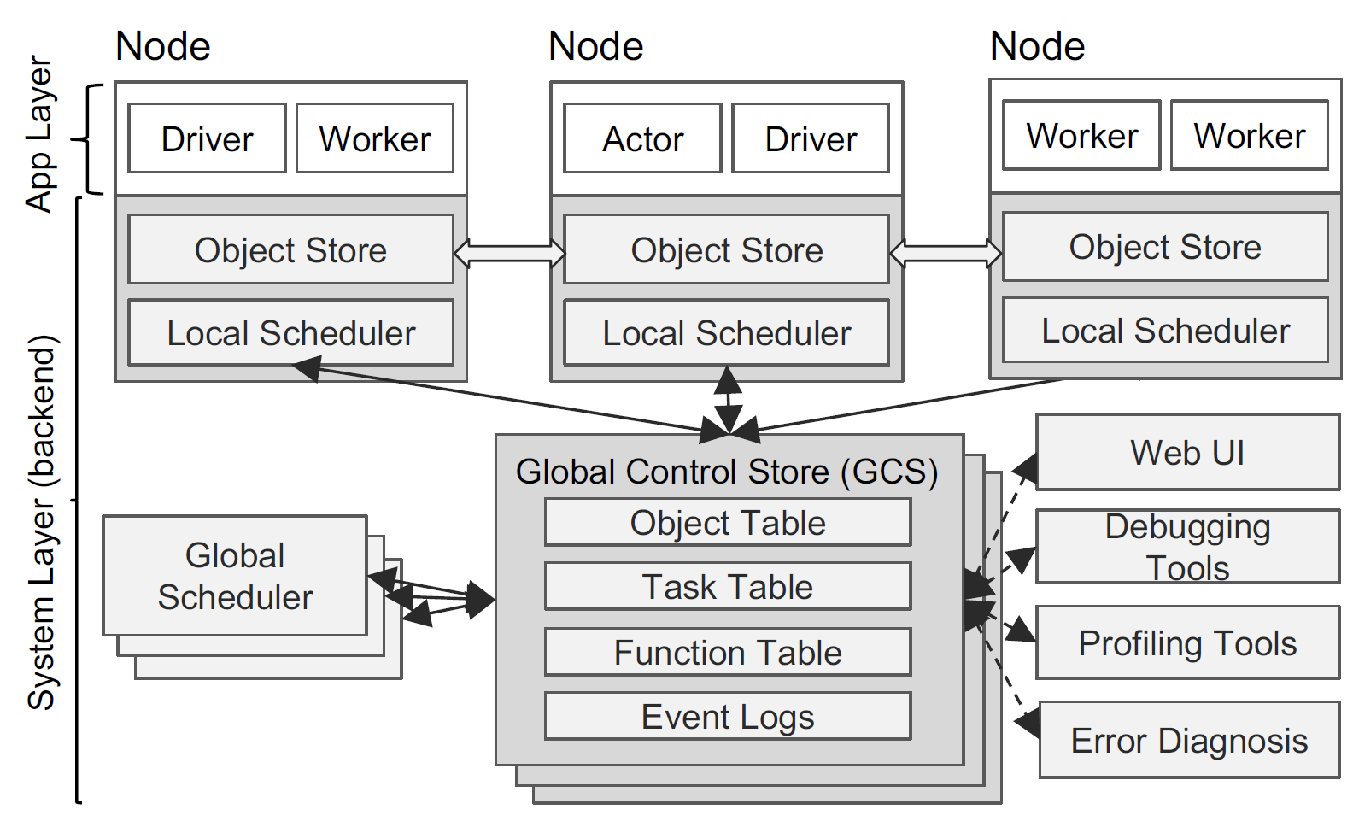
Ray's Architecture
Ray's architecture consists of two parts: an application layer and a system layer.
The application layer implements the API and the computation model.
The system layer implements task scheduling and data management to satisfy the performance and fault-tolerance requirements.

Slide 10
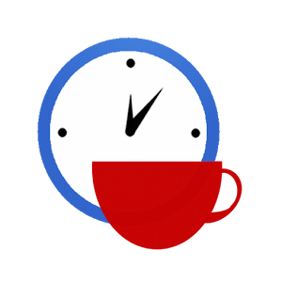

Slide 11
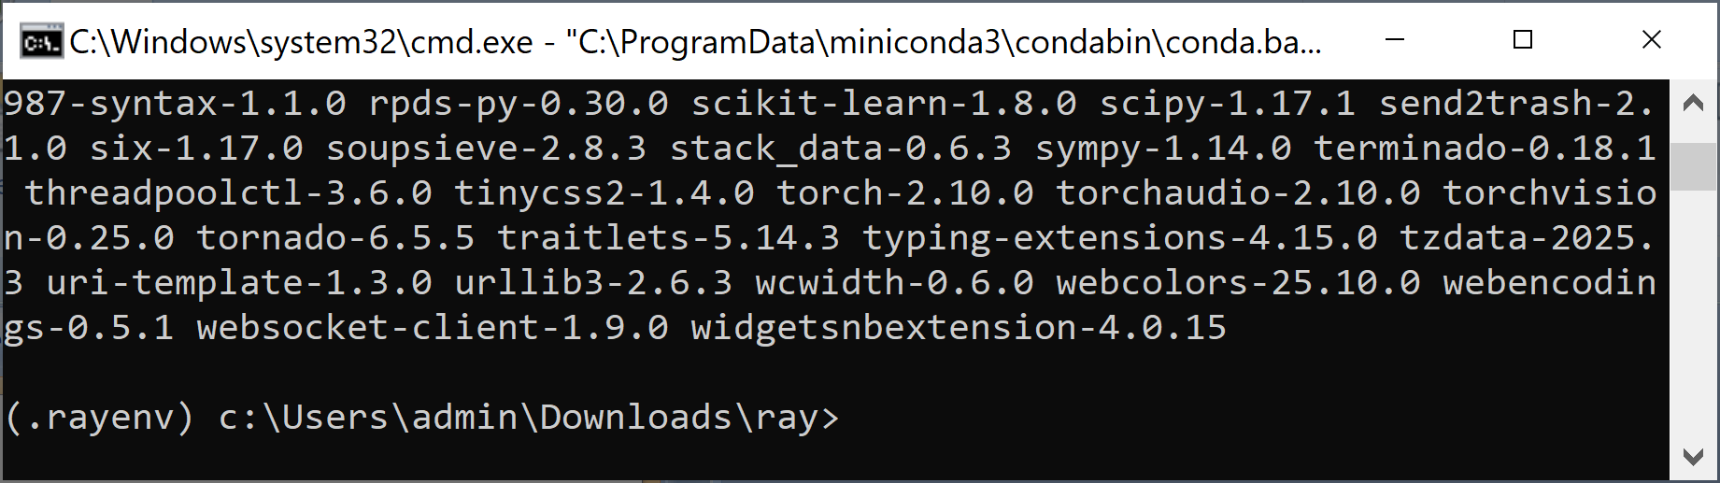
1. Prepare Environment
mkdir ray
cd ray
conda create -n .rayenv python=3.11
conda activate .rayenv
pip install --upgrade jupyter matplotlib numpy pandas scipy scikit-learn torch torchvision torchaudio

Slide 12
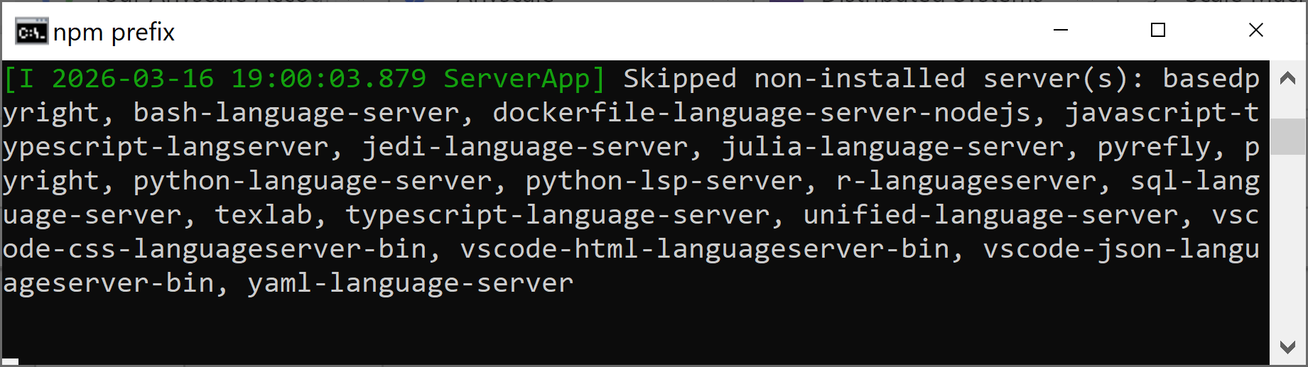
2. Install Ray
https://docs.ray.io/en/latest/ray-overview/installation.html
pip install -U "ray[data,train,tune,serve]"
pip install -U "ray[rllib]"
jupyter notebook --ip 0.0.0.0 --port 8888

Slide 13
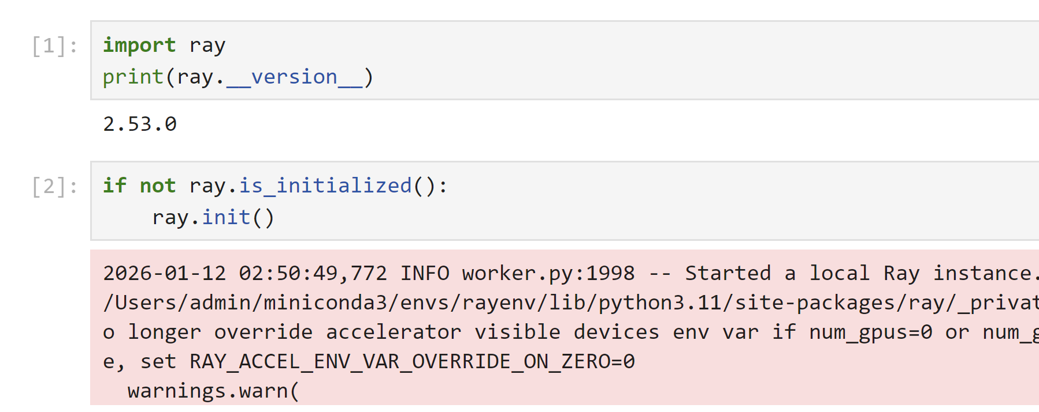
3. Hello Ray
import ray
print(ray.__version__)
https://docs.ray.io/en/latest/ray-overview/getting-started.html

Slide 14
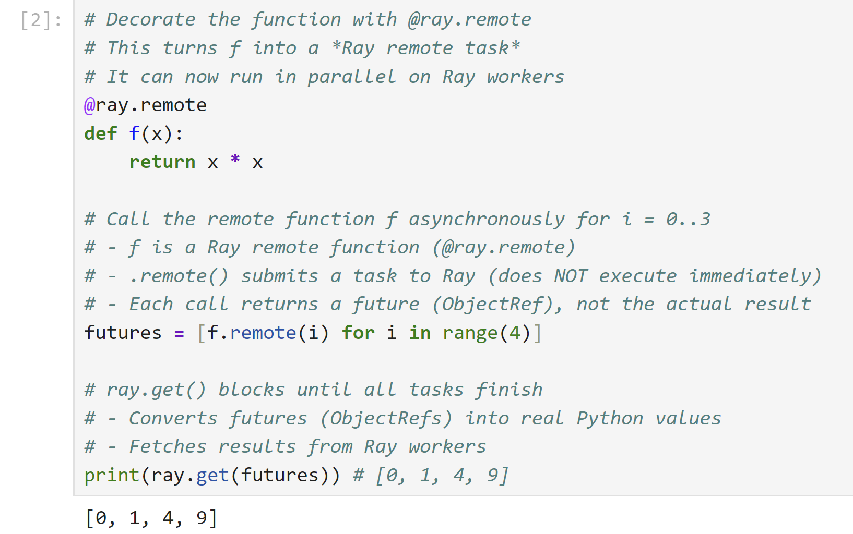
4. Hello Ray Tasks and Actors
https://docs.ray.io/en/latest/ray-overview/getting-started.html

Slide 15
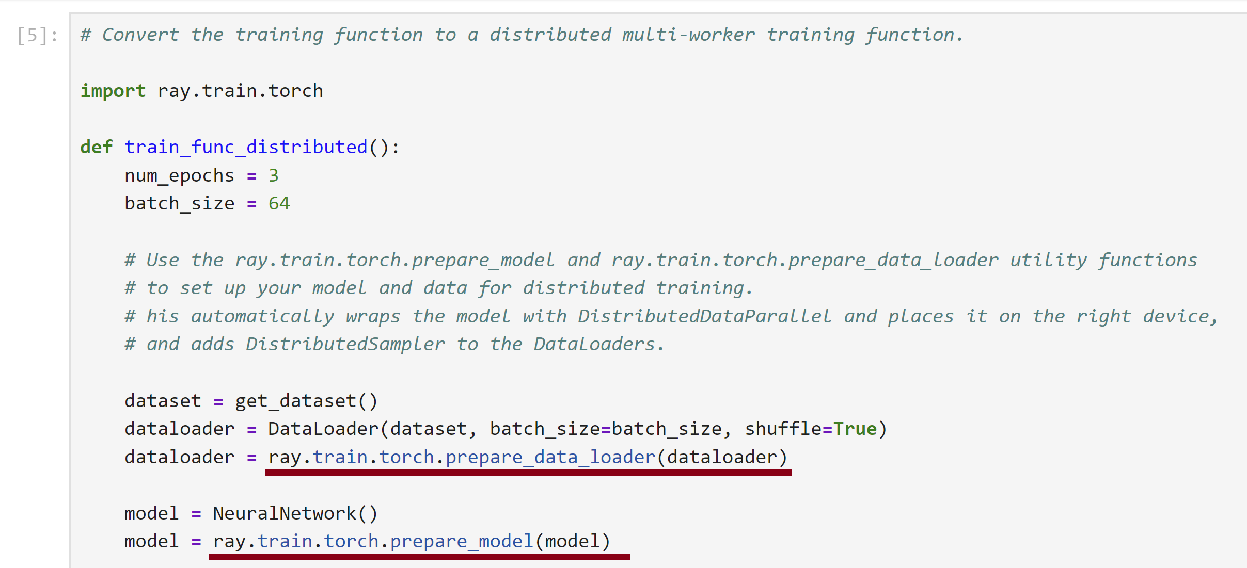
5. Hello Ray Train
https://docs.ray.io/en/latest/ray-overview/getting-started.html

Slide 17
An Introduction to Ray Serve [2]
Ray Serve is a scalable compute layer for serving ML models on top of Ray.
Serve is framework-agnostic, meaning that it isn’t tied to a specific ML library; rather, it treats models as ordinary Python code.
Additionally, it allows you to flexibly combine normal Python business logic alongside ML models.
This makes it possible to build online inference services completely: a Serve application could validate user input, query a database, perform scalable inference across multiple ML models, and combine, filter, and validate the output—all in the process of handling a single inference request.
Indeed, combining the results of multiple ML models is one of the key strengths of Ray Serve.

Slide 18
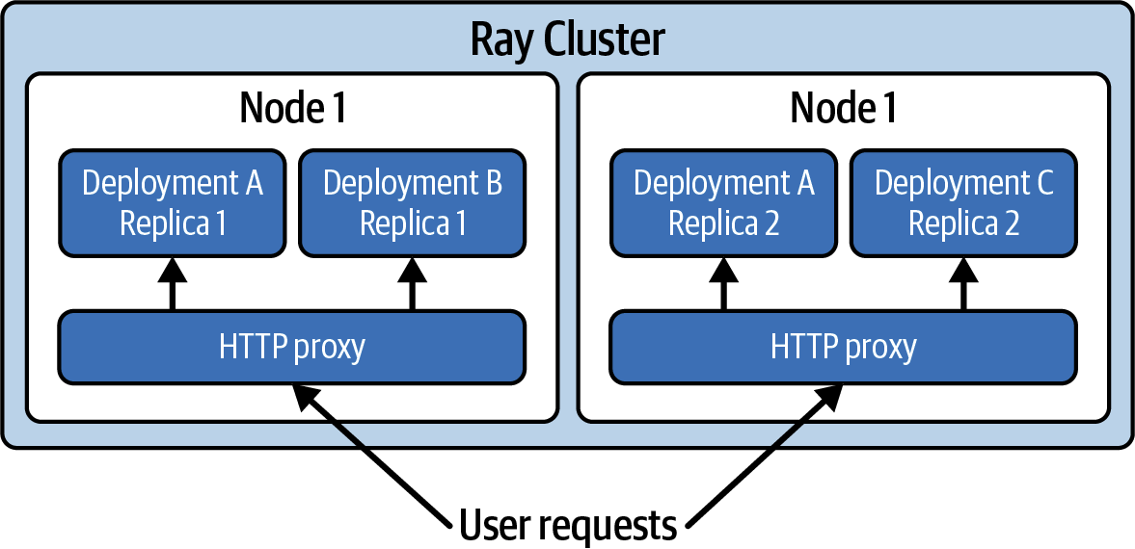
The Architecture of a Ray Serve Application

Slide 19
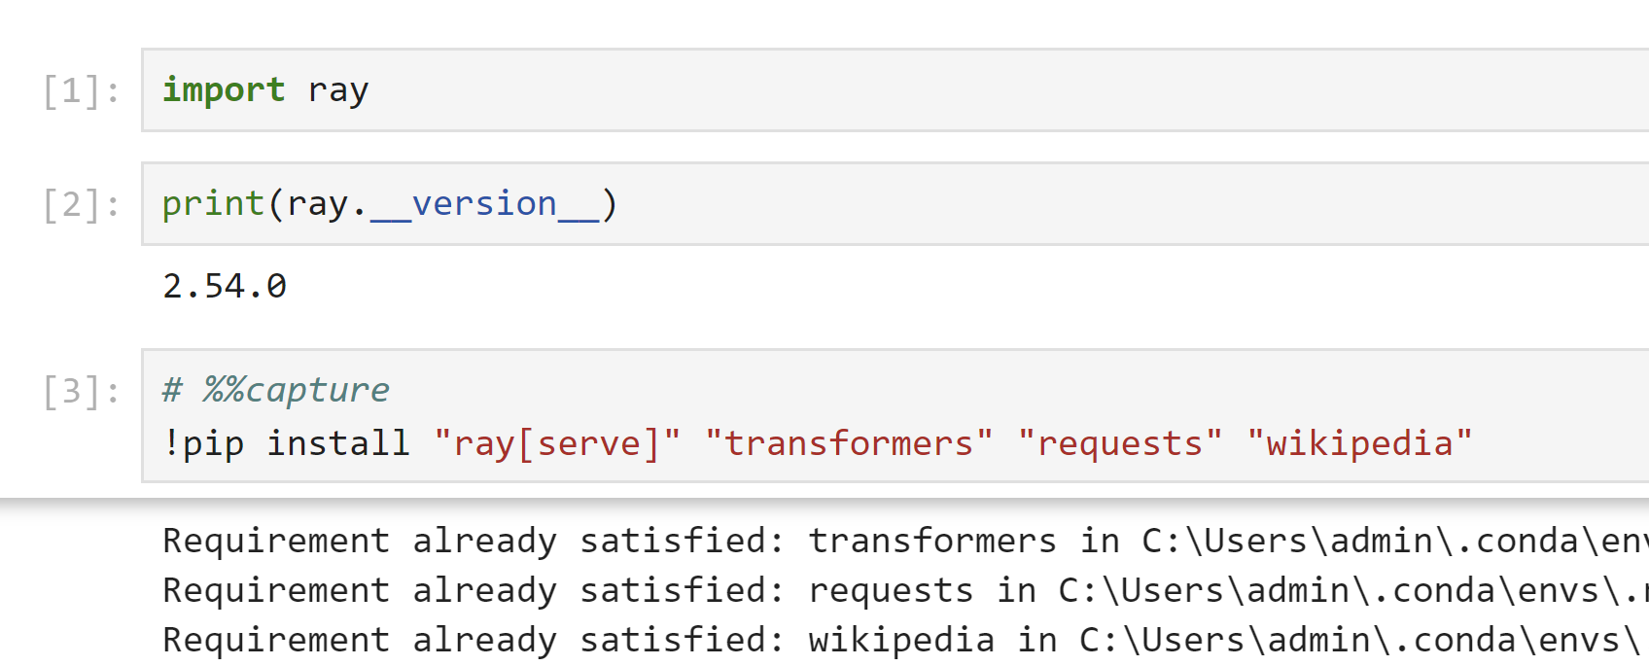
1. Install Packages
!pip install "ray[serve]" "transformers" "requests" "wikipedia"

Slide 20
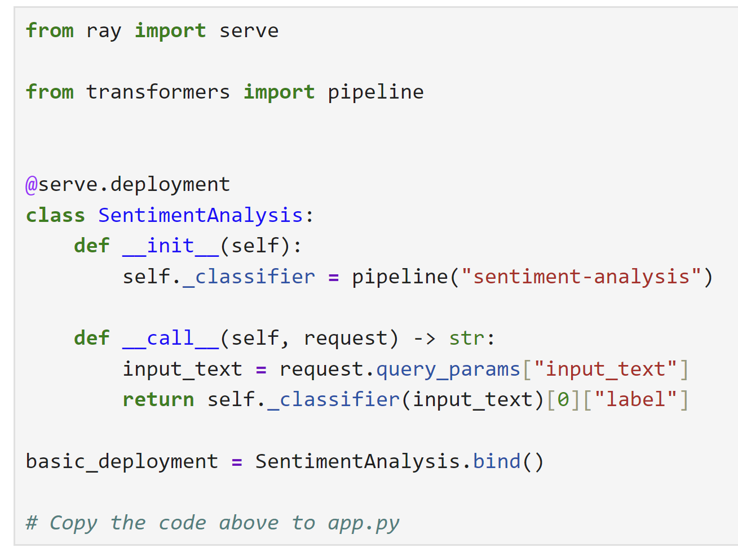
2. Prepare Deployment
Copy the code to app.py

Slide 21
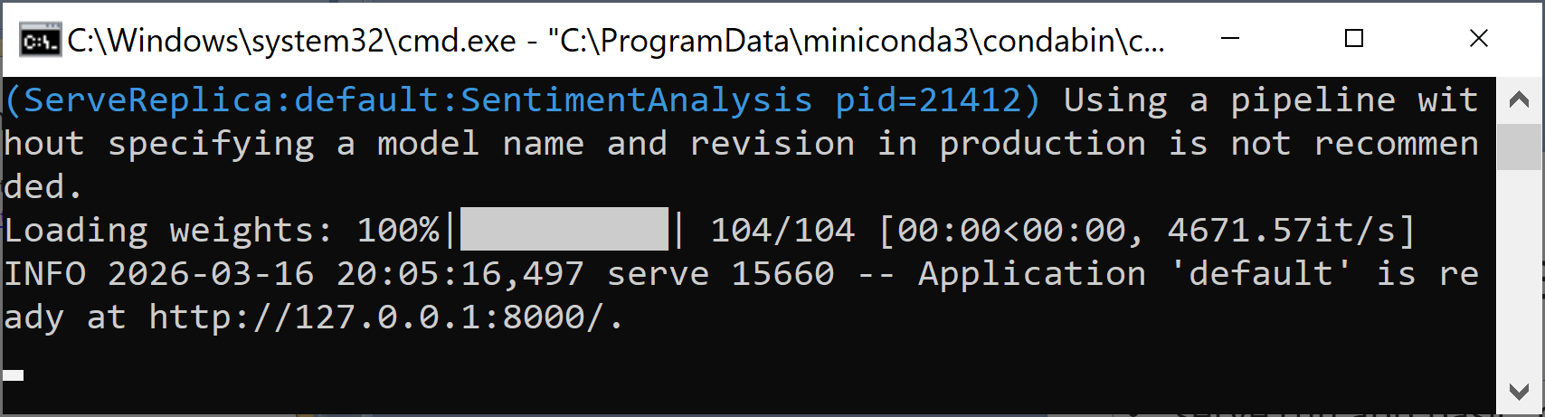
3. Run the Deployment
serve run app:basic_deployment
# Wait until the app is ready at http://127.0.0.1:8000

Slide 22
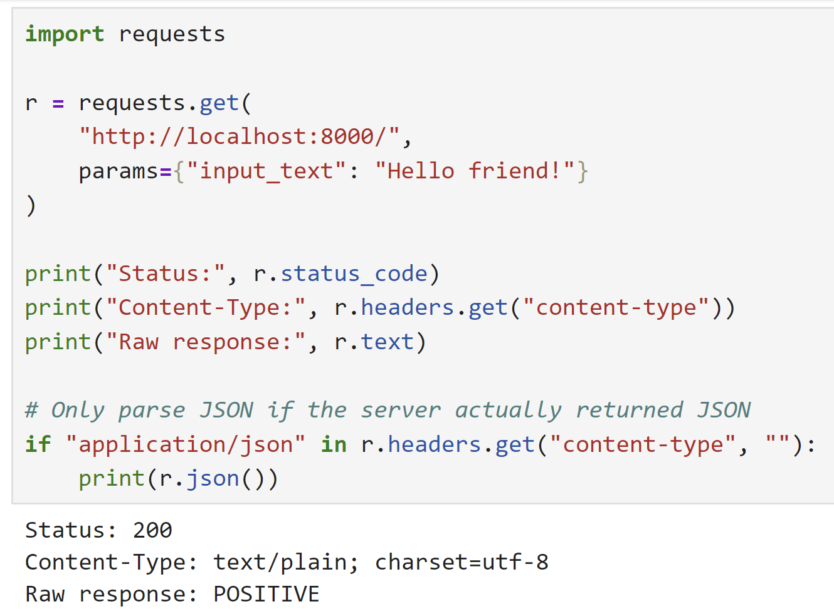
4. Call the API

Slide 24
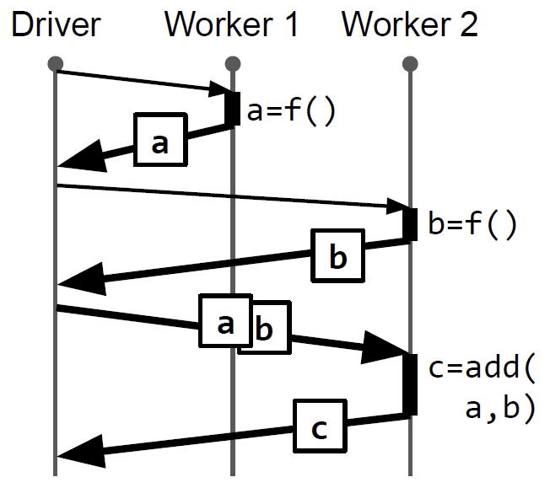
RPC [3]
RPC is a standard for building distributed applications because of its generality and because its simple semantics yield high-performance implementations.
The original proposal uses synchronous calls that copy return values back to the caller.

Slide 25
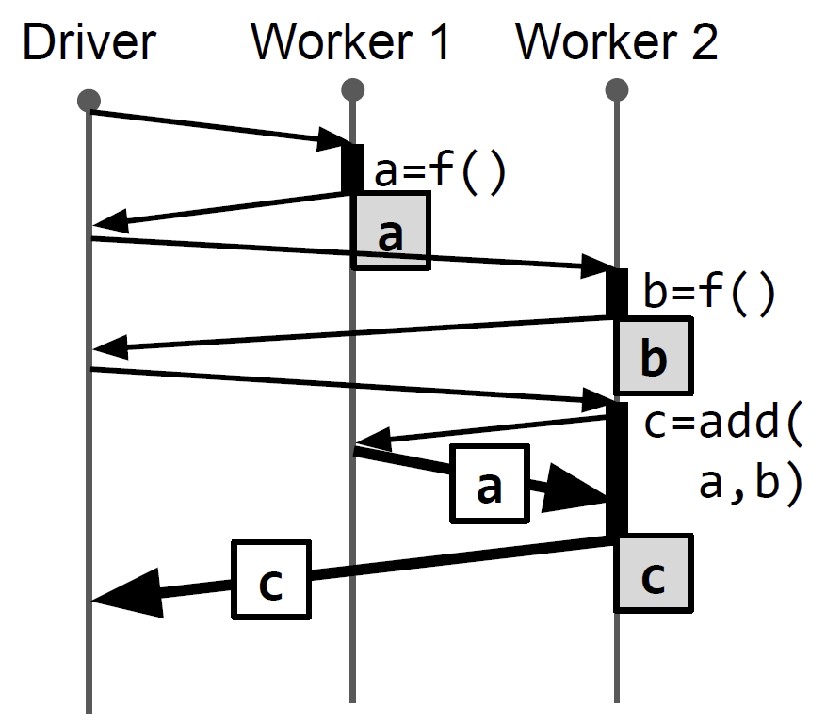
Data Movement
Several recent systems have extended RPC so that, in addition to distributed communication, the system may also manage data movement and parallelism on behalf of the application.
To reduce data copies, some RPC systems use distributed memory. This allows large arguments to be passed by reference, while small arguments can still be passed by value. In the best case, arguments passed by reference to an RPC do not need to be copied if they are already on the same node as the executor.
Note that, like traditional RPC, we make all values immutable to simplify the consistency model and implementation.

Slide 26
Promises [4]
A promise is essentially a placeholder for a future result of an asynchronous call.
When a procedure is invoked remotely, it returns a promise immediately, allowing the caller to proceed with other tasks without blocking.
The caller can later retrieve the result using the promise once it becomes available, or the system can implicitly handle the result when needed.
This approach contrasts with synchronous RPCs by reducing idle time and enabling the caller to overlap computation with communication.

Slide 27
JavaScript Promise Example
function fetchDataAsync() {
console.log(`Fetching data on thread: ${process.pid}`);
return fetch('https://jsonplaceholder.typicode.com/posts/1')
.then(response => response.json())
.then(data => `Data from server: ${data.title}`);
}
console.log(`Starting the program on thread: ${process.pid}`);
const promise = fetchDataAsync();
console.log("Doing other work while waiting for the data...");
promise.then(result => {
console.log(result);
console.log("Program finished.");
}).catch(error => {
console.error("Error:", error);
});

Slide 28
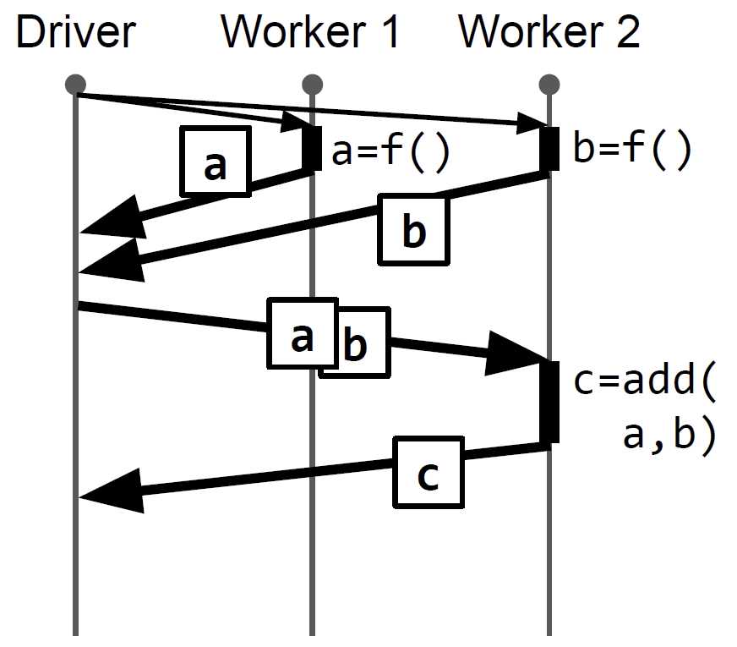
Parallelism [3]
RPCs are traditionally blocking, so control is only returned to the caller once the reply is received.
Futures are a popular method for extending RPC with asynchrony, allowing the system to execute functions in parallel with each other and the caller.
With composition, i.e., passing a future as an argument to another RPC, the application can also express the parallelism and dependencies of future RPCs.

Slide 29
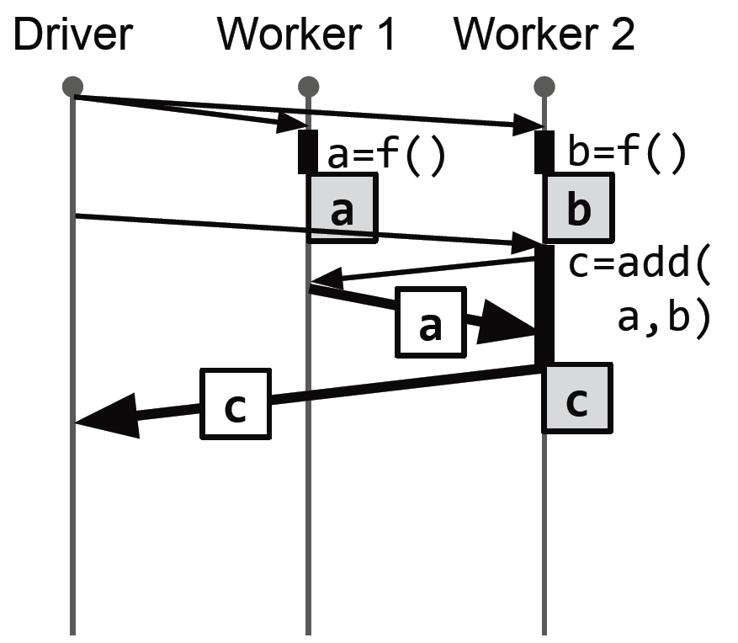
Distributed Futures
Distributed futures are an extension of RPC that combines futures with distributed memory: a distributed future is a reference whose eventual value may be stored on a remote node.
An application can then express distributed computation without having to specify when or where execution should occur and data should be moved.
This is an increasingly popular interface for developing distributed applications that manipulate large amounts of data.

Slide 30
Fine-grained Functions
As with traditional RPC, a key goal is generality. To achieve this, the system must minimize the overhead of each function call.
For example, the widely used gRPC provides horizontal scalability and sub-millisecond RPC latency, making it practical to execute millions of fine-grained functions, i.e. millisecond-level “tasks”, per second.

Slide 31
Coarse-grained Tasks
There are emerging examples of large-scale, fine-grained applications of distributed futures, including reinforcement learning, video processing, and model serving.
These applications must optimize parallelism and data movement for performance, making distributed futures apt.
Unfortunately, existing systems for distributed futures are limited to coarse-grained tasks.

Slide 32
Ownership
In this paper, we present a distributed futures system for fine-grained tasks.
While others have implemented distributed futures before, our contribution is in identifying and addressing the challenges of providing fault tolerance for fine-grained tasks without sacrificing performance.

Slide 33
Why Not Just Use gRPC?
gRPC provides raw RPC calls (synchronous or asynchronous via gRPC’s async API). While you can wrap responses in futures (e.g., using ListenableFuture in Java), this is a client-side construct, not a distributed abstraction. You’re still explicitly calling a specific service endpoint.
gRPC treats data as ephemeral—each call sends a request and gets a response, with no built-in mechanism for referencing or sharing data across nodes beyond what the application implements.
gRPC assumes you know which server to call and handles communication between endpoints. Scaling to a cluster requires a separate scheduler or load balancer, and task placement is the application’s responsibility.
gRPC offers basic reliability (e.g., retries, timeouts), but fault tolerance for a computation graph (e.g., recovering a failed task’s output) is outside its scope. You’d need to log task states or replay logic manually.
gRPC is communication protocol, not a full distributed computing framework. It’s a building block for point-to-point calls, not a system for managing distributed workflows.

Slide 34
gRPC vs. Ownership
The paper doesn’t dismiss gRPC’s capability for fine-grained tasks—it leverages gRPC’s efficiency as a comparison point.
However, Ownership isn’t “just gRPC” because it solves a higher-level problem: managing distributed futures for fine-grained, dynamic, data-intensive workloads.
gRPC could be a component (e.g., for communication), but it doesn’t replace the need for Ownership’s abstractions, especially in scenarios where task graphs, distributed memory, and fault tolerance are critical.

Slide 35

Thank You & See You Again

